Slide 1
Intuitive Introduction to the Important Ideas of Inference
Robin Lock – St. Lawrence University
Patti Frazer Lock – St. Lawrence University
Kari Lock Morgan – Duke / Penn State
Eric F. Lock – Duke / U Minnesota
Dennis F. Lock – Iowa State / Miami Dolphins
ICOTS9 Flagstaff, AZ
July 2014

Slide 2
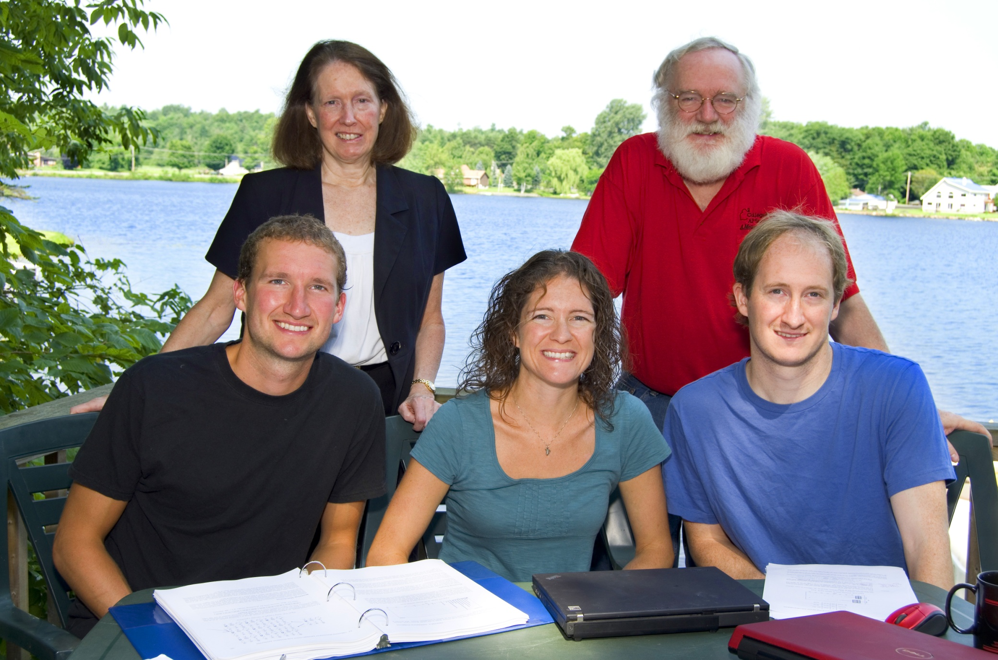
The Lock⁵ Team
Robin & Patti
St. Lawrence
Dennis
Iowa State/ Miami Dolphins
Kari
Duke / Penn State
Eric
Duke / UMinn

Slide 3
Outline
Estimating with confidence (Bootstrap)
Understanding p-values (Randomization)
Implementation
Organization of simulation methods?
Role for distribution-based methods?
Textbook/software support?

Slide 4
U.S. Common Core Standards (Grades 9-12)
Statistics: Making Inferences & Justifying Conclusions
HSS-IC.A.1 Understand statistics as a process for making inferences about population parameters based on a random sample from that population.
HSS-IC.A.2 Decide if a specified model is consistent with results from a given data-generating process, e.g., using simulation.
HSS-IC.B.3 Recognize the purposes of and differences among sample surveys, experiments, and observational studies; explain how randomization relates to each.
HSS-IC.B.4 Use data from a sample survey to estimate a population mean or proportion; develop a margin of error through the use of simulation models for random sampling.
HSS-IC.B.5 Use data from a randomized experiment to compare two treatments; use simulations to decide if differences between parameters are significant.
Statistics: Making Inferences & Justifying Conclusions
HSS-IC.A.1 Understand statistics as a process for making inferences about population parameters based on a random sample from that population.
HSS-IC.A.2 Decide if a specified model is consistent with results from a given data-generating process, e.g., using simulation.
HSS-IC.B.3 Recognize the purposes of and differences among sample surveys, experiments, and observational studies; explain how randomization relates to each.
HSS-IC.B.4 Use data from a sample survey to estimate a population mean or proportion; develop a margin of error through the use of simulation models for random sampling.
HSS-IC.B.5 Use data from a randomized experiment to compare two treatments; use simulations to decide if differences between parameters are significant.
Notes:
bozz

Slide 5
Example #1: Body Temperatures
Sample of body temperatures (in ºF) for n=50 students
(Shoemaker, JSE, 1996)
$$n=50 \overline{x}=98.26 s=0.765$$
Goal: Find an interval that is likely to contain the mean body temperature for all students
Key concept: How much should we expect the sample means to vary just by random chance?
Can we estimate this using ONLY data from this sample?

Slide 6
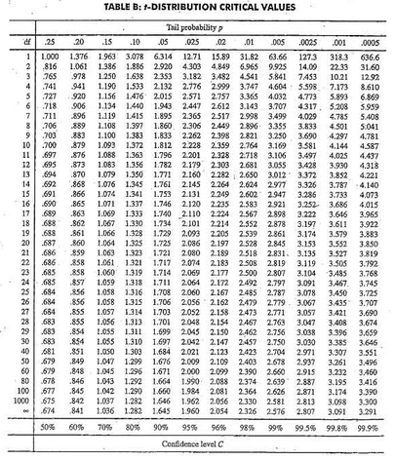
Traditional Inference
1. Check conditions
CI for a mean
2. Which formula?
$$\overline{x}±z^{∗}∙σ/{\sqrt{n}}$$
OR
$$\overline{x}±t^{∗}∙s/{\sqrt{n}}$$
3. Calculate summary stats
$n=50, \overline{x}=98.26$, $s=0.765$
4. Find t*
5. df?
95% CI ⇒ $α/2=\frac{1−0.95}{2}=0.025$
df=5$0−$1=49
t*=2.009
6. Plug and chug
$$98.26±2.009∙{0.765}/{\sqrt{50}}$$
$$98.26±0.22=(98.04, 98.48)$$
7. Interpret in context

Slide 7
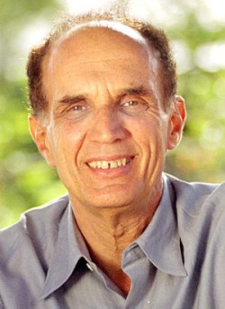
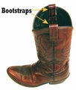
Bootstrapping
Brad Efron
Stanford University
“Let your data be your guide.”
Basic Idea:
Create simulated samples, based only the original sample data, to approximate the sampling distribution and standard error of the statistic.

Slide 8
Bootstrapping
Brad Efron
Stanford University
“Let your data be your guide.”
To create a bootstrap distribution:
Assume the “population” is many, many copies of the original sample.
Simulate many “new” samples from the population by sampling with replacement from the original sample.
Compute the sample statistic for each bootstrap sample.

Slide 9
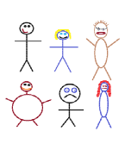
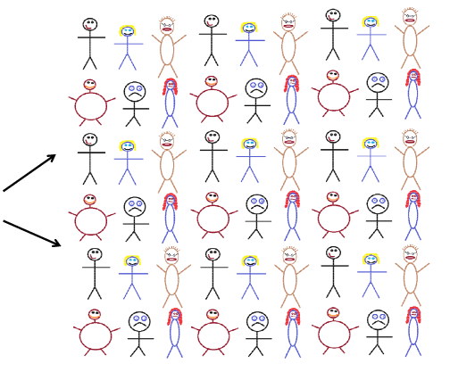
Finding a Bootstrap Sample
Original Sample (n=6)
A simulated “population” to sample from
Bootstrap Sample
(sample with replacement from the original sample)
Notes:
Patti

Slide 10
Bootstrap Sample
Original Sample
99.3 96.4 98.6 99.0 99.5
98.2 98.7 99.3 98.8 97.2
99.0 98.2 99.0 98.9 98.2
99.0 97.7 96.8 98.3 98.2
97.2 96.4 98.5 98.4 98.8
100.8 99.0 96.8 98.3 98.2
98.0 97.6 97.6 96.8 97.6
98.9 97.7 98.9 98.4 100.8
98.1 98.6 98.3 97.7 99.0
98.4 98.6 99.4 97.4 99.0
99.3 96.4 98.6 99.0 99.5
98.2 98.7 99.3 98.8 97.2
99.0 98.2 99.0 98.9 98.2
99.0 97.7 96.8 98.3 98.2
97.2 96.4 98.5 98.4 98.8
100.8 99.0 96.8 98.3 98.2
98.0 97.6 97.6 96.8 97.6
98.9 97.7 98.9 98.4 100.8
98.1 98.6 98.3 97.7 99.0
98.4 98.6 99.4 97.4 99.0
99.3 96.4 98.6 99.0 99.5
98.2 98.7 99.3 98.8 97.2
99.0 98.2 99.0 98.9 98.2
99.0 97.7 96.8 98.3 98.2
97.2 96.4 98.5 98.4 98.8
100.8 99.0 96.8 98.3 98.2
98.0 97.6 97.6 96.8 97.6
98.9 97.7 98.9 98.4 100.8
98.1 98.6 98.3 97.7 99.0
98.4 98.6 99.4 97.4 99.0
99.3 96.4 98.6 99.0 99.5
98.2 98.7 99.3 98.8 97.2
99.0 98.2 99.0 98.9 98.2
99.0 97.7 96.8 98.3 98.2
97.2 96.4 98.5 98.4 98.8
100.8 99.0 96.8 98.3 98.2
98.0 97.6 97.6 96.8 97.6
98.9 97.7 98.9 98.4 100.8
98.1 98.6 98.3 97.7 99.0
98.4 98.6 99.4 97.4 99.0
99.3 96.4 98.6 99.0 99.5
98.2 98.7 99.3 98.8 97.2
99.0 98.2 99.0 98.9 98.2
99.0 97.7 96.8 98.3 98.2
97.2 96.4 98.5 98.4 98.8
100.8 99.0 96.8 98.3 98.2
98.0 97.6 97.6 96.8 97.6
98.9 97.7 98.9 98.4 100.8
98.1 98.6 98.3 97.7 99.0
98.4 98.6 99.4 97.4 99.0
97.6 99.4 99.0 98.8 98.0
98.9 99.0 97.8 96.8 99.0
98.4 98.8 97.8 98.9 98.4
96.9 99.5 98.8 97.6 97.9
97.7 98.3 97.4 100.8 98.3
98.2 98.0 97.8 97.2 98.2
97.4 97.5 98.2 98.0 98.4
99.3 98.2 98.1 97.7 99.0
98.5 98.6 98.8 98.4 98.7
96.4 98.0 97.7 98.2 98.7
$$\overline{x}=98.35$$
98.8 99.0 96.9 98.8 97.6
97.5 98.0 98.2 98.0 97.8
98.7 98.2 98.7 97.8 97.9
96.8 97.6 100.8 96.8 98.2
98.4 97.7 96.9 100.8 98.3
98.3 98.8 98.2 97.7 97.8
98.7 99.3 99.3 98.4 98.7
98.0 98.2 98.4 97.8 97.5
97.8 98.4 97.4 98.7 97.5
99.0 97.7 98.7 97.8 98.7
$$\overline{x}=98.26$$
Repeat 1,000’s of times!
$$\overline{x}=98.22$$
Notes:
Robin

Slide 11
BootstrapSample
Bootstrap Statistic
BootstrapSample
Bootstrap Statistic
Original Sample
Bootstrap Distribution
●
●
●
Many times
●
●
●
StatKey
Sample Statistic
We need technology!
BootstrapSample
Bootstrap Statistic

Slide 12
StatKey
www.lock5stat.com/statkey
Freely available web apps with no login required
Runs in (almost) any browser (incl. smartphones/tablets)
Google Chrome App available (no internet needed)
Standalone or supplement to existing technology
* ICOTS talk on StatKey: Session 9B, Thursday 7/17 at 10:55
Notes:
Patti

Slide 13
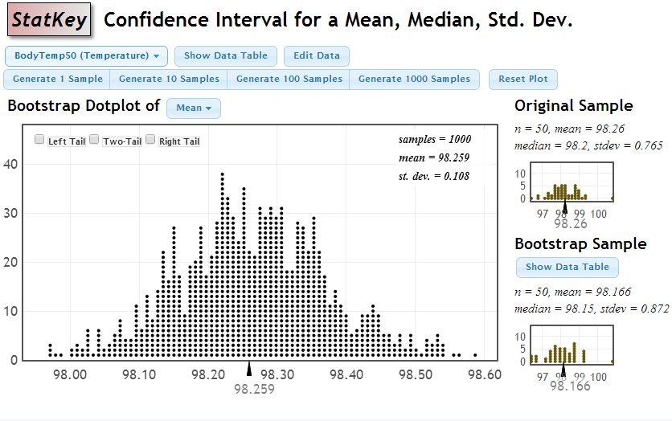
Bootstrap Distribution for Body Temp Means

Slide 14
How do we get a CI from the bootstrap distribution?
Method #1: Standard Error
Find the standard error (SE) as the standard deviation of the bootstrap statistics
Find an interval with
$$Original Statistic±2⋅SE$$

Slide 15
Bootstrap Distribution for Body Temp Means
Standard Error
$98.26±2∙\left(0.108\right)=(98.04, 98.48$)

Slide 16
How do we get a CI from the bootstrap distribution?
Method #1: Standard Error
Find the standard error (SE) as the standard deviation of the bootstrap statistics
Find an interval with
$$Original Statistic±2⋅SE$$
Method #2: Percentile Interval
For a 95% interval, find the endpoints that cut off 2.5% of the bootstrap means from each tail, leaving 95% in the middle

Slide 17
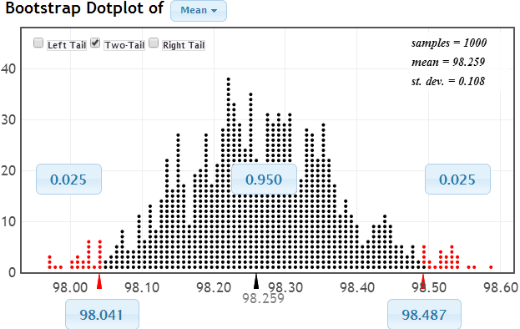
95% Confidence Interval
Chop 2.5% in each tail
Keep 95% in middle
Chop 2.5% in each tail
We are 95% sure that the mean body temperature for all students is between 98.04ºF and 98.49ºF

Slide 18
Bootstrap Confidence Intervals
Version 1 (Statistic ± 2 SE):
Great preparation for moving to
traditional methods
Version 2 (Percentiles):
Great at building understanding of
confidence intervals
Same process works for different parameters
Notes:
Rups

Slide 19
Why
does the bootstrap work?

Slide 20
Sampling Distribution
Population
BUT, in practice we don’t see the “tree” or all of the “seeds” – we only have ONE seed
µ
Notes:
Robin

Slide 21
Bootstrap Distribution
What can we do with just one seed?
Estimate the distribution and variability (SE) of $\overline{x}$’s from the bootstraps
Bootstrap
“Population”
Grow a NEW tree!
$$\overline{x}$$
µ
Chris Wild: Use the bootstrap errors that we CAN see to estimate the sampling errors that we CAN’T see.
Notes:
Robin

Slide 22
Golden Rule of Bootstraps
The bootstrap statistics are to the original statistic
as
the original statistic is to the population parameter.

Slide 23
Example #2: Sleep vs. Caffeine
Volunteers shown a list of 25 words.
Before recall: Randomly assign to either
Sleep (1.5 hour nap) OR Caffeine (and awake)
Measure number of words recalled.
Does this provide convincing evidence that the mean number of words recalled after sleep is higher than after caffeine or could this difference be just due to random chance?
 | n | mean | stdev
Sleep | 12 | 15.25 | 3.31
Caffeine | 12 | 12.25 | 3.55
Mednick, Cai, Kannady, and Drummond, “Comparing the Benefits of Caffeine, Naps and Palceboon Verbal, Motor and Perceptual Memory” Behavioural Brain Research (2008)

Slide 24
Example #2: Sleep vs. Caffeine
H₀: μ_{S} = μ_{C}
H_{a}: μ_{S} > μ_{C}
µ = mean number of words recalled
Based on the sample data:
${ \overline{x}}_{S}−{\overline{x}}_{C}=15.25−12.25=3$.0
Is this a “significant” difference?
How do we measure “significance”? ...

Slide 25
KEY IDEA
P-value: The proportion of samples,
when H₀ is true, that would give results as (or more) extreme as the original sample.
Say what????

Slide 26
Traditional Inference
1. Check conditions
2. Which formula?
5. Which theoretical distribution?
$$t=\frac{{\overline{x}}_{S}−{\overline{x}}_{C}}{\sqrt{\frac{s_{S}^{2}}{n_{S}}+\frac{s_{C}^{2}}{n_{C}}}}$$
6. df?
7. Find p-value
8. Interpret a decision
3. Calculate numbers and plug into formula
$$t=\frac{15.25−12.25}{\sqrt{\frac{{3.31}^{2}}{12}+\frac{{3.55}_{}^{2}}{12}}}$$
4. Chug with calculator
$$t=2.14$$
0.025 < p-value < 0.050

Slide 27
Randomization Approach
Create a randomization distribution by simulating many samples from the original data, assuming H₀ is true, and calculating the sample statistic for each new sample.
Estimate p-value directly as the proportion of these randomization statistics that exceed the original sample statistic.
Notes:
Bozz

Slide 28
Randomization Approach
Number of words recalled
To simulate samples under H₀ (no difference):
Re-randomize the values into Sleep & Caffeine groups
Sleep
9
11
13
14
14
15
16
17
17
18
18
21
Caffeine
6
7
10
10
12
12
13
14
14
15
16
18
$${\overline{x}}_{s}=15.25$$
$${\overline{x}}_{c}=12.25$$
Original Sample
$${\overline{x}}_{s}−{\overline{x}}_{c}=3.0$$

Slide 29
Randomization Approach
Number of words recalled
To simulate samples under H₀ (no difference):
Re-randomize the values into Sleep & Caffeine groups
Sleep
9
11
13
14
14
15
16
17
17
18
18
21
Caffeine
6
7
10
10
12
12
13
14
14
15
16
18
6
7
9
10
10
11
12
12
13
13
14
14
14
14
15
15
16
16
17
17
18
18
18
21
$${\overline{x}}_{s}=15.25$$
$${\overline{x}}_{c}=19.22$$
$${\overline{x}}_{s}−{\overline{x}}_{c}=3.0$$

Slide 30
Randomization Approach
Number of words recalled
To simulate samples under H₀ (no difference):
Re-randomize the values into Sleep & Caffeine groups
Compute ${\overline{x}}_{s}−{\overline{x}}_{c}$
Sleep
Caffeine
6
10
10
11
12
12
13
13
14
14
14
14
15
15
16
16
17
17
18
18
18
21
7
9
10
10
12
13
14
14
15
16
17
17
18
11
12
13
14
14
15
16
18
18
21
Repeat this process 1000’s of times to see how “unusual” is the original difference of 3.0.
$${\overline{x}}_{s}=13.50$$
$${\overline{x}}_{c}=14.00$$
StatKey
$${\overline{x}}_{s}−{\overline{x}}_{c}=−0.50$$

Slide 31
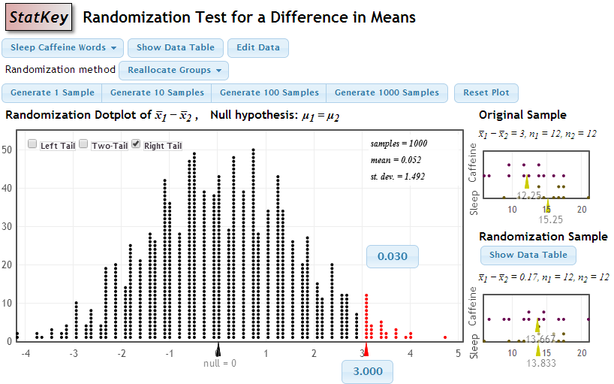
p-value = proportion of samples, when H₀ is true, that are as (or more) extreme as the original sample.
p-value

Slide 32
Implementation Issues
What about traditional (distribution-based) methods?
Intervals first or tests?
One Crank or Two?
Textbooks?
Technology/Software?

Slide 33
How does everything fit together?
We use simulation methods to build understanding of the key ideas of inference.
We then cover traditional normal and t-based procedures as “short-cut formulas”.
Students continue to see all the standard methods but with a deeper understanding of the meaning.

Slide 34
Intro Stat – Revise the Topics
Descriptive Statistics – one and two samples
Descriptive Statistics – one and two samples
Normal distributions
Bootstrap confidence intervals
Bootstrap confidence intervals
Data production (samples/experiments)
Data production (samples/experiments)
Randomization-based hypothesis tests
Randomization-based hypothesis tests
Sampling distributions (mean/proportion)
Normal distributions
Confidence intervals (means/proportions)
Hypothesis tests (means/proportions)
ANOVA for several means, Inference for regression, Chi-square tests
Notes:
Bozz

Slide 35
Transition to
Traditional Inference
Confidence Interval:
$$Sample Statistic ±z^{∗}∙SE$$
$\text{(}\text{or} t^{∗}$)
Hypothesis Test:
$$z=\frac{Sample Statisic−Null Parameter}{SE}$$
Need to know:
Formula for SE
Conditions to use a “traditional” distribution
Notes:
M Lock

Slide 36
One Crank or Two? John Holcomb (ICOTS8)
Crank #1: Reallocation
Example: Scramble the sleep/caffeine labels in the word memory experiment
Crank #2: Resample
Example: Sample body temps with replacement to get bootstrap samples
Example: Suppose we sampled 12 “nappers” and 12 “caffeine” drinkers to compare word memory...

Slide 37
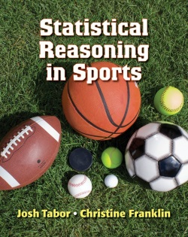
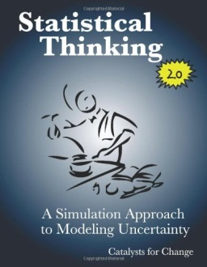
Textbooks?
Statistical Reasoning in Sports (WH Freeman)
Tabor & Franklin
Statistics: Unlocking the Power of Data (Wiley)
Lock, Lock, Lock Morgan, Lock, Lock
Statistical Thinking: A Simulation Approach to Modeling Uncertainty (Catalyst Press)
Zieffler & Catalysts for Change
Introduction to Statistical Investigations (Wiley)
Tintle, Chance, Cobb, Rossman, Roy, Swanson and VanderStoep

Slide 38
Software?
StatKey
www.lock5stat.com/statkey
Rossman/Chance Applets
www.rossmanchance.com
VIT: Visual Inference Tools Chris Wild
www.stat.auckland.ac.nz/~wild/VIT/
Mosaic (R package) Kaplan, Horton, Pruim
http://mosaic-web.org/r-packages/
Fathom/TinkerPlots Finzer, Konold

Slide 39
Thanks for Listening! Questions?
Robin – rlock@stlawu.edu
Patti – plock@stlawu.edu
Kari – klm47@psu.edu
Eric – Eric.F.Lock@gmail.com
Dennis – DLock@dolphins.com
All – lock5stat@gmail.com

